Slide 1

EXPLAINING THE
PETROLUEM DRIVER PASSPORT
^{WWW.PDPPASSPORT.COM}

Slide 2
AN
INDUSTRY
INITIATIVE
BACKED BY GOVERNMENT

Slide 3
CONTENTS
BACKGROUND
05
NAME CHANGE
07
DOWNSTREAM FUEL DISTRIBUTION FORUM
12
WHAT IS THE PETROLEUM DRIVER PASSPORT (PDP) AND HOW DOES IT WORK?
13
TRAINING CENTRES
21
ENFORCEMENT
24
FEE STRUCTURE
25
BENEFITS
27
FURTHER INFORMATION
28

Slide 4


Slide 5

The petroleum tanker industry can point to many examples of excellence in driver training. However there was no common standard to which all drivers were trained, and:
INDUSTRY BACKGROUND
Drivers need no more formal training than an ADR
ADR applies to many categories of driver and does not cover petroleum tanker specifics
Some training is good but there is also inconsistency
Terminal induction often has to fill a training gap
ADR is classroom only training, tanker driving is a practical job

Slide 6
DECC, following the recommendations of the ACAS negotiated process, requested that UK Downstream Oil Industry Forum be reconvened, to undertake a review of best practice in health and safety and driver training standards with the aim of incorporating this into a new industry-wide Code of Practice.
Downstream Oil Distribution Forum: re-established, working with industry and relevant authorities, in July 2012 to manage this work (first met 2004). Membership was drawn widely to cover -Retail, Commercial, Home Heat, Aviation & Marine deliveries.
The Forum is the industry body responsible for the PDP initiative.
ORIGINS OF THE PDP

Slide 7

NAME CHANGE
In 2023, it was agreed that, light of the moves to alternative energy sources and fuels, it was timely to re-brand the Downstream Oil Distribution Forum (DODF). The Forum will be called the Downstream Fuel Distribution Forum (DFDF) from July 2023 to reflect the sector’s evolution. There will be a period of transition whilst the name is changed on all Forum and PDP Scheme documentation.

Slide 8
PURPOSE
to deliver a consistently high level of classroom and practical training to all classes of petroleum tanker driver, sitting within a system of accreditation and enforcement by industry, delivered in the most cost effective manner, thereby ensuring all petroleum tanker drivers are trained to the same high standard

Slide 9
OUTPUT
drivers who meet this standard and keep it up to date are issued with the “Petroleum Driver Passport”

Slide 10

SCOPE
The PDP is an industry led and created initiative for everyone in the UK registered petroleum tanker business
The PDP is a DRIVER card, all drivers should have a PDP regardless of employer, type of vehicles, grade(s) of petroleum product, or loading point
The PDP definition of a terminal is ‘anywhere that petroleum products are loaded’
DFDF want all terminal operators, regardless of size, to mandate the PDP

Slide 11

DRIVER AND VEHICLE ASSURANCE
This means there are now industry accredited checks for both the driver and the vehicle:
- Safe Loading Pass: Vehicle
- Petroleum Driver Passport: Driver

Slide 12
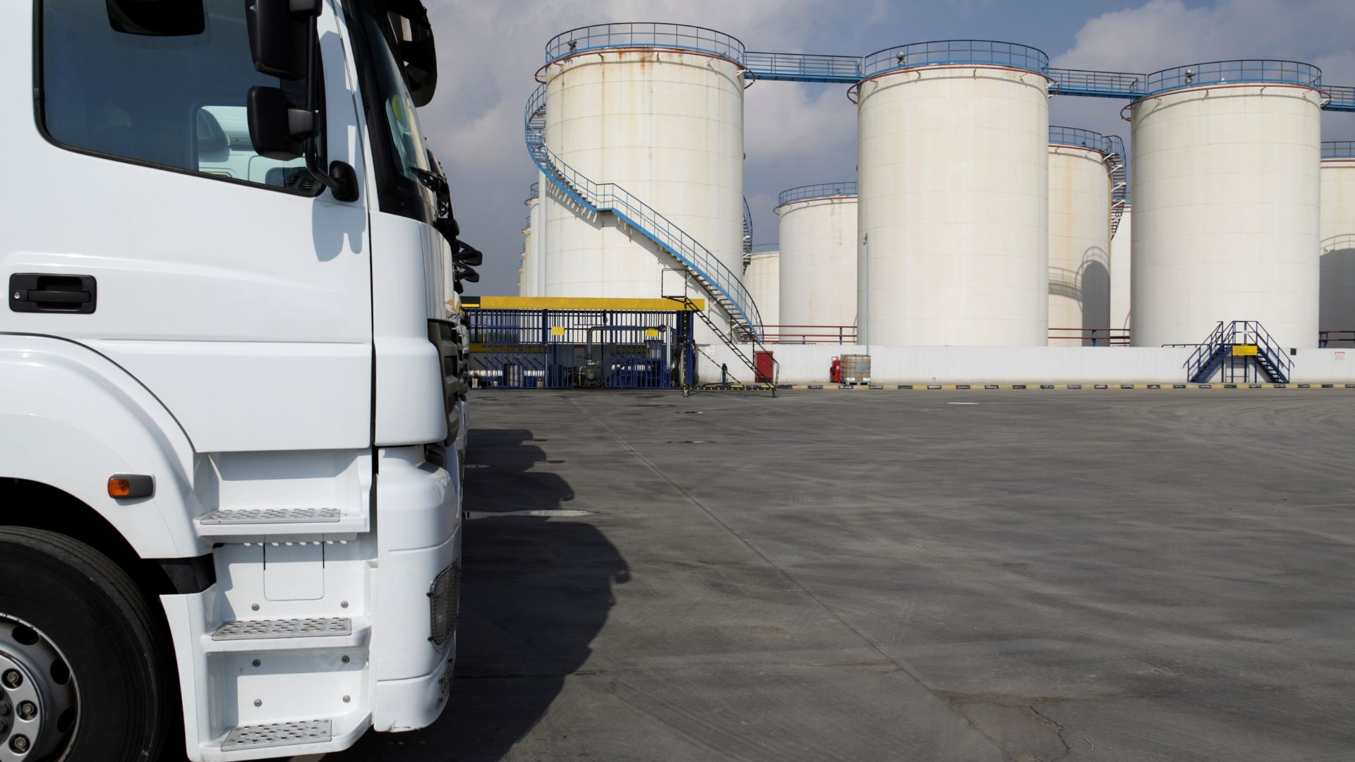
DOWNSTREAM FUEL DISTRIBUTION FORUM (DFDF)
DFDF has industry wide representation
DFDF created and owns the PDP
DFDF appointed Scottish Qualifications Authority (SQA) as Scheme Manager for PDP
DFDF and PDP have a UK mandate
Haulage Companies
Unions (Unite and URTU)
Trade Associations
Major Employers/Terminal Operators
Government and Regulatory Bodies (DESNZ, DfT)

Slide 13

WHAT IS THE PETROLEUM DRIVER PASSPORT?
1
Training Standard
2
PDP Syllabus
all petroleum tanker driver required knowledge and practical skills, whether already covered in ADR or not
sets a minimum standard and operators are free to exceed it should they wish
the Training Standard minus those parts already covered in ADR
a classroom “PDP module” and a practical load, drive and tip assessment
3
5 yearly written assessment and annual practical assessment
4
System of Approval and Enforcement
The training standard and the system of approval and enforcement work together to create the PDP

Slide 14
SYSTEM OF APPROVAL AND
ENFORCEMENT
SQA approve all activity within the scheme (Training Centres, Trainers, Practical Assessors)
Training Centres carry out the training to approved standards (can be in-house or third party organisations)
SQA set the external assessments, Training Centres invigilate
SQA employ External Verifiers to audit PDP activities
PDP is enforced through the Terminal operators (see later)
Other relevant authorities and operators are aware of PDP (e.g. DVSA, PELG, HSE, Police, VOSA, EA and others)

Slide 15
HOW DOES THE PDP WORK:
OVERVIEW
Five year cycle in line with driver ADR renewal cycle
Classroom training and written assessment
Practical load, drive and tip assessment
Successful completion of the classroom assessment AND the practical assessment results in the issue of the Petroleum Driver Passport by SQA
Annual Refresher Training
Essential to maintain PDP validity
Classroom refresher training and successful completion of practical assessment
DVSA compliance, so training hours can count towards driver CPC
PDP is gained through the five year assessed renewal, but must be maintained through annual refresher activity in each interim year

Slide 16
DRIVER FULL 5 YEAR
PDP RENEWAL
Full renewal every five years, can be aligned with individual driver ADR renewal date
Classroom Training
Delivered as the “PDP Module”, which covers knowledge relevant to all classes of petroleum tanker
Delivered by approved PDP training centres
Drivers take the module and then sit an SQA managed written assessment invigilated by the Training Centre, preferably on-line
industry sub sector knowledge is not part of the PDP classroom Module or the written assessment (as not relevant to all)
Sub sector knowledge and practical requirements are built into the Training Standard and designed to assist driver training when new to a sub sector
Practical Training
Practical assessment carried out to approved load, drive tip assessment sheet
Practical Assessors approved, may well be different from Classroom Assessors
Pass/fail mark with results communicated to SQA by Training Centre/Assessor

Slide 17
DRIVER
ANNUAL REFRESHER
PDP is gained through the five year assessed renewal, and its validity must be maintained through annual refresher activity in each interim year
Completion of a classroom annual refresher, recapping on key points and updating on changes of content and emphasis - SQA must be informed that the refresher has taken place
Completion of a load, drive and tip practical assessment with an approved PDP Practical Assessor -SQA must be informed that the practical assessment has taken place
Practical assessment and classroom refresher are subject to SQA verification through a process of selective audit
PDP Syllabus contains suggestions for annual refresher content
Annual refresher training can be undertaken as a DVSA-approved course thus registering Driver CPC hours

Slide 18
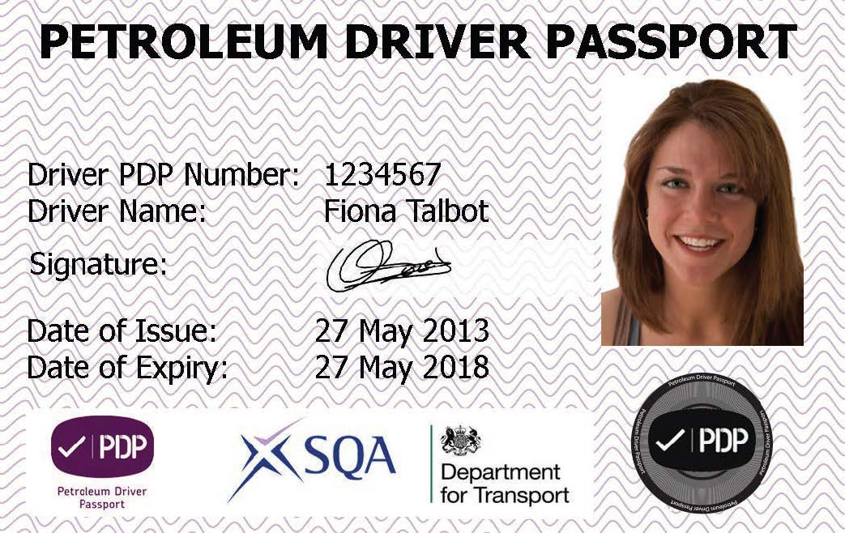
PDP CARD
DESIGN

Slide 19
RE-VALIDATION AND
LOST CARDS
If the annual refresher training is not kept up to date the PDP will become invalid
An invalid card cannot be used
There may be good reasons for why cards may become inactive (e.g. illness, driver duties change)
PDP can be re-activated by:
  Sitting a classroom annual refresher
  Taking and passing a load, drive and tip practical assessment
  Registering successful completion with SQA
>
pdpassport@sqa.org.uk
LOST CARDS CAN BE REPLACED BY CONTACTING SQA

Slide 20
INDUSTRY SUB SECTORS AND THE
PRACTICAL ASSESSMENT
Some Drivers may work on more than one of the five industry sub sectors (Retail, Commercial, Home Heat, Aviation & Marine)
Only one practical assessment is required for the five year renewal/annual practical refresher
The five year and the annual refresher should be taken on the sub sector in which the Driver most frequently works
If a Driver is new to a sub sector, a practical load, drive and tip assessment should be carried out in that sub sector

Slide 21

TRAINING
CENTRES
All training centres, their trainers, course content and practical assessors must be approved through SQA
Centres are subject to verification checks by SQA
New training centres can apply to SQA for approval and can select which PDP activities to register for
Existing centres can register for new additional activities if they wish (e.g. annual refresher, practical assessment)
Centres pay an initial approval fee followed by annual approval fee

Slide 22

PRIMARY ENFORCEMENT:
TERMINALS
1
The primary point of enforcement for this industry code of practice is at the Terminals by Terminal Operators and independent legal advice has confirmed it is lawful to do so for drivers of UK registered vehicles
2
PDP definition of a terminal is anywhere petroleum tankers drivers load designated product
3
Terminal operators are required to demonstrate due diligence in allowing rack access
4
Terminal Operators will request proof of PDP at induction before granting loading pass (terminal induction will still be required)
5
Terminal operators will spot check the PDP in line with their own spot check procedures

Slide 23
SECONDARY
ENFORCEMENT
In addition to the terminal operators there are other Authorities / interested parties who may request the PDP, including
Potential for recording PDP driver number on delivery paperwork
All customers
HSE and Environment Agency as part of inspections and investigations
VOSA and Police
SQA and DFDF will also act as an enforcement point:
Approval activities
External verifiers checking on quality of PDP activity
DFDF hold sanction powers working with SQA

Slide 24

PDP FEE STRUCTURE
PRINCIPLES
Fees detailed below are PDP Scheme fees charged by SQA as the Scheme Manager
Fees are charged by activity
Fees are recovered from training centres and employers/drivers
The SQA charged PDP fees are in addition to any cost for taking the PDP module and for the annual refresher and practical activities
Fees determined and set by DFDF in consultation with SQA
The fee structure covers PDP scheme management costs
Driver fee payment is by activity:
Each activity is split into its individual parts
A fee when the driver takes the written classroom 5 year PDP assessment
A fee when the practical assessment is logged with SQA
Refresher training fee for the annual classroom and the practical, and similarly with re-validation

Slide 25
ACTIVITY | DESCRIPTION | FEE
Training Centre Application and Annual Fee: Full approval | This is the application and annual fee for a centre who will be delivering all elements for the scheme. PDP 5 year classroom and written assessment, 5 year practical assessment, Annual Refresher, and Revalidation. | £500 on application and £500 annual fee
Training Centre Application and Annual Fee: PDP classroom module only | This is the application and annual fee for a training centre delivering the 5 year PDP classroom module and written assessment only. | £150 on application and £200 annual fee
Training Centre Application and Annual Fee: PDP annual refresher training and assessment, and revalidation training and assessment only | This is the application and annual fee for a training centre who will deliver the on-going annual, and revalidation training and assessment only | £200 on application and £250 annual fee
Training Centre Application and Annual Fee: Practical assessor only | This is the application and annual fee for a centre who deliver only the annual and 5 year practical assessment only | £200 on application and £250 annual fee
Training Centre Application and Annual Fee: Annual, revalidation training and practical assessment | This is the application and annual fee for a centre who will deliver the annual and revalidation training, and the five year and annual practical assessment | £400 on application and £500 annual fee
PDP FEE STRUCTURE
TRAINING
CENTRE

Slide 26
ACTIVITY | DESCRIPTION | FEE
Candidate Enrolment Fee: 5 year full written assessment | Fee paid by a candidate to undertake the 5 year classroom training and written assessment. The fee includes the cost of issuing of the passport | £30
Candidate Enrolment Fee: 5 year practical assessment | Fee paid by a candidate to undertake the 5 year practical assessment. The fee includes the cost of issuing of the passport | £19
Annual Refresher Training Enrolment Fee: Classroom | Fee paid to enrol a candidate for the annual classroom refresher training | £19
Annual Refresher Training Enrolment Fee: Practical | Fee paid to enrol a candidate for the annual practical assessment | £19
Revalidation Enrolment Fee: Classroom | Fee paid to enrol a candidate for the revalidation classroom training | £27.50
Revalidation Enrolment Fee: Practical | Fee paid to enrol a candidate for the revalidation practical training | £27.50
Replacement Card Fee | Fee charged for lost or stolen card | £15
PDP FEE STRUCTURE
CANDIDATE

Slide 27
IN SUMMARY
BENEFITS OF THE PDP
DRIVERS
EMPLOYERS
TERMINALS
TREANING CENTRES
INDUSTRY
are consistently trained annually to a high standard
have a standard against which to train all drivers, whether training is delivered in-house or externally. Scheme is linked to ADR and to driver CPC
know that the PDP means drivers are appropriately trained; where appropriate complements terminals’ competence assurance systems
clear syllabus and strong PDP accreditation and assessment process
reputational improvement, maintaining high standards in training and safety, industry providing its own pro-active code of practice

Slide 28
FURTHER INFORMATION
^{WWW.PDPPASSPORT.COM}
SCHEME MANAGER (SQA) -PDPASSPORT@SQA.ORG.UK
^{DFDF FACILITATOR} ^{-JENNY.CLUCAS@COGENTSKILLS.COM}
^{DFDF CHAIR} ^{-PETEROAKFORD@HOTMAIL.COM}
PDP TRAINING STANDARD, SYLLABUS & SCHEME MANUAL OF PRACTICE (WHICH HAS FULL DETAIL OF PDP) -DOWNLOADS AVAILABLE ON PDP WEBSITE

