Slide 1
Transport Liaison and Alternative Energy Group
Sub Officer Micky Bhasin
Lithium Batteries
Electronic Powered Personal Vehicles (EPPV)/Electric Vehicles(EV) and dangers to first responders
Notes:
Who are we – We oversee all major infrastructure projects in London – Thames Tideway, Crossrail, The River Thames, Roads, Tunnels, HS2,

Slide 2
Transport Liaison and Alt Energy Group projects consist of:
Crossrail
HS2
All underground and overground railways in London
Silverlink Tunnel
Alternative Fuels/Electric Vehicles
Airports (Heathrow, City, Biggin Hill, RAF Northolt
River Thames
Road Tunnels
Any major transport infrastructure project within London
Notes:
Who are we – We oversee all major infrastructure projects in London – Thames Tideway, Crossrail, The River Thames, Roads, Tunnels, HS2,

Slide 3
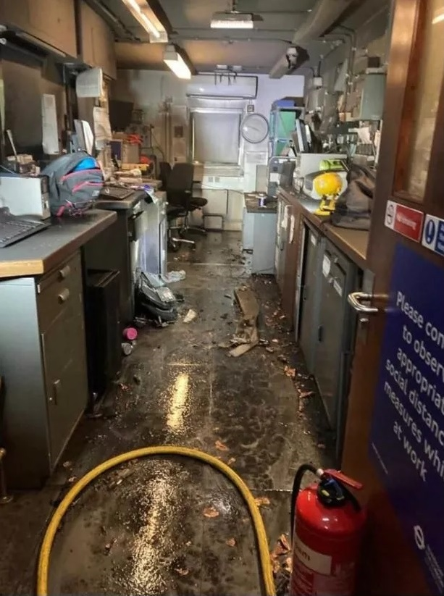
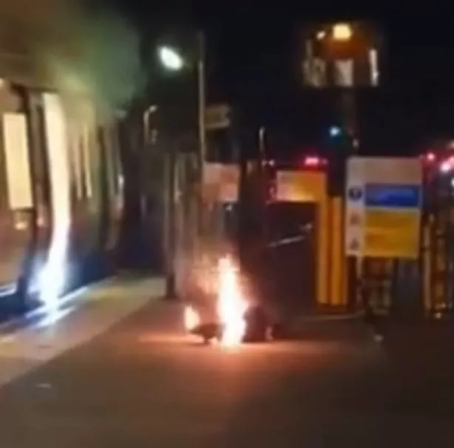
Where it began
Above was a fire involving an E unicycle
at Stanmore LU station
Days later, an e-scooter fire at
Parsons Greens LU Station
This led to meeting with TfL and a ban of
e-scooters and e-unicycles on the entire
TfL network which includes their River, Rail,
LU, Buses, DLR and Tram services.
Notes:
On top is Stanmore LU station – Fire from e-unicycle
On the bottom is Parson Green fire from e-scooter
The Transport Liaison Group/LFB already had concerns before both these incidents occurred. It led to the implantation of banning e-scooters and E-Unicycles from the entire TfL network. This includes LU, River and Buses etc
Action has recently been taken by several rail operators implementing a ban due to the risk associated with e-scooters and other EPPVs.
So far in 2023, LFB has attended 80 fires involving e-bikes and 17 involving e-scooters which is 4 times as many incidents as those involving e-scooters. We are not aware of any EPPV fires on public transport this year.

Slide 4













Partnerships and Organisations
Notes:
The TLG have been educating and liaising with partners and organisations across London as well as Globally into the safe use of Lithium batteries.
There is most definitely a place for this type of technology within London but more research and development in adequate safety is required.
They allow for a cheaper alternative way to travel, allow people with limited mobility to navigate London easier and is apparently a fun mode of transport (I’ve never used one personally)
We must do all we can to ensure those that use E-bikes/E-scooters and other modes of Electric Powered Personal Vehicles are kept well informed of the hazards and risks associated with them.
The LFB has implemented the #chargesafe Campaign

Slide 5
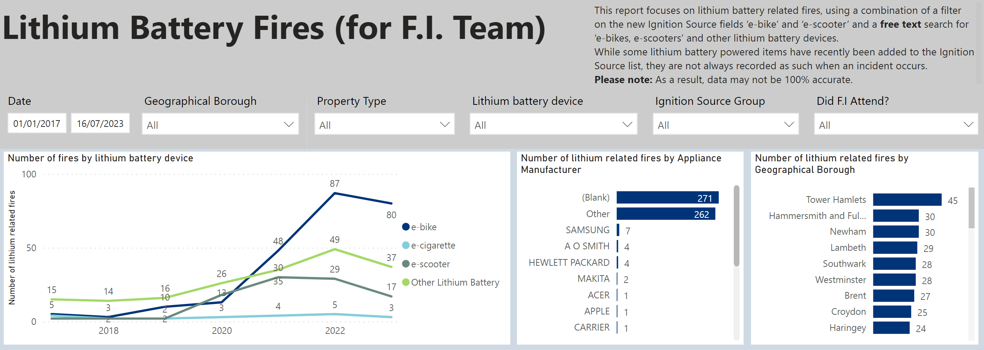
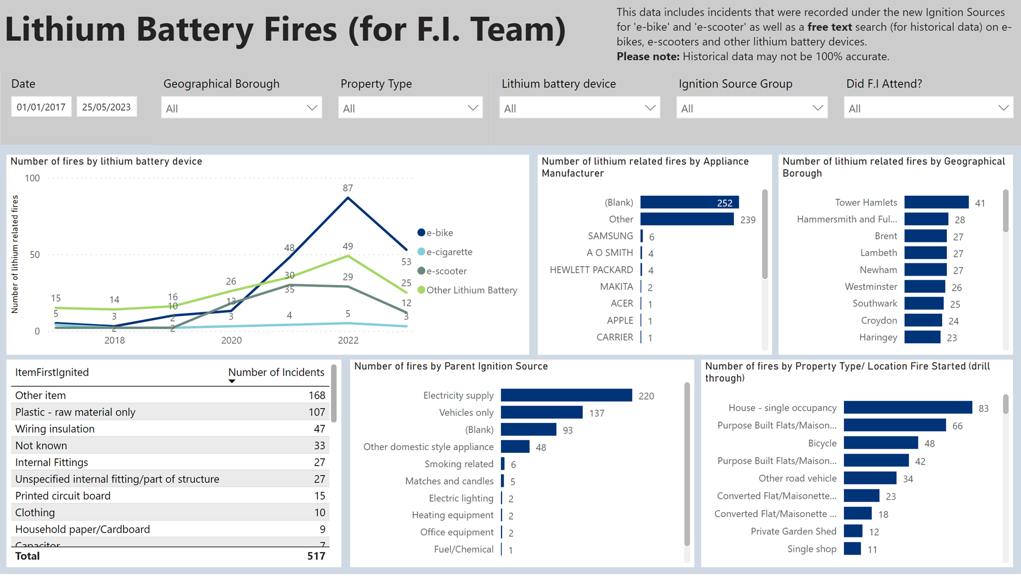
Why have we taken this approach?
We are the only Fire and Rescue Service that have been collecting data on Lithium Batteries since 2017
Incidents since 2021 increased dramatically which is why we as an organisation have had to act
We are attending 4.8 lithium battery incidents every week (Data supplied from 17th July 2023)
Our aim is to prevent fire deaths and injuries related to this type of technology and ensure
members of the public are kept safe
Operational crew safety is paramount which is why we have created standard operating procedures and policy
when dealing with lithium battery incidents
This project has led to collaborative working with pretty much every department within the LFB
Notes:
Our latest data shows that firefighters have attended 80 e-bike fires already in 2023. 17 E-Scooters, 2 fully electric buses

Slide 6
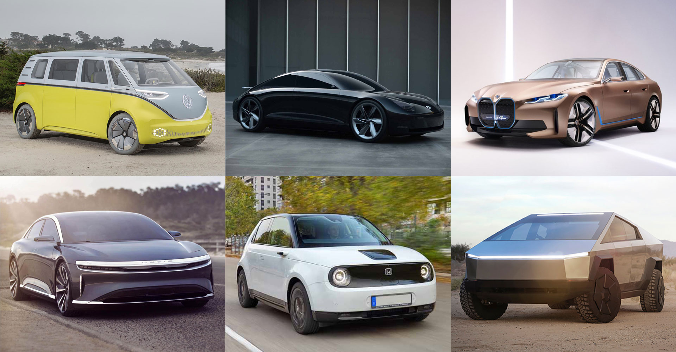
Electric Vehicles
Notes:
Thermal runaway (TR)
TR can be caused by battery impact, over or undercharging or from defects within the battery’s material from manufacture it can also fail if it gets too hot/cold or penetrated.
Thermal Runaway is irreversible chemical reaction which can potentially lead to flames jetting out from the battery casing, burning debris (battery cells) being ejected from the battery and possible explosion in a confined space due to the flammable vapour.
Toxicity
When a lithium battery burns it emits plumes of white smoke.
Traditionally white smoke has been associated with steam and therefore not particularly dangerous.
Unfortunately, this is not the case with Li batteries as this smoke may contain highly toxic chemicals such as HF, HCl and CO.
Run-off issues
Large volumes of water are required to cool Li battery fires – typically in excess of 20,000 litres for medium sized electric vehicle.
On a forecourt drainage systems could be overwhelmed. The runoff would be mixed with toxic compounds, so can also lead to environmental concerns as well as toxicity risk to people. Early engagement with the environmental agency must be made
Re-ignition
Li batteries can have the potential to reignite hours or even days after initial ignition.
This poses a risk for both first responders as it is difficult to know whether it is completely extinguished and similarly for recovery agencies, MET Police forensics and insurance companies when inspecting a damaged EV.

Slide 7
Electric Vehicles EVs
How many plug-in vehicles in London?
Year No. of plug-in Vehicles in London
2011 1,576
2012 1,666
2013 1,983
2014 3,257
2015 5,581
2016 8,583
2017 13,896
2018 20,623
2019 32,425
2020 48,422
2021 69,172
Ref Department for Transport
Notes:
The year-on-year increase in plug in vehicles - Plug-in vehicles are defined by the DfT as all models identified as being battery electric, plug-in hybrid electric, or range-extended electric.
Across the UK as of the end of April 2023, there were more than 1,250,500 plug-in cars with over 760,000 battery electric vehicles. Source - DfT

Slide 8
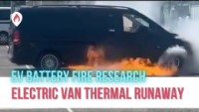
Notes:
Heathrow Airport
In summary of the circumstance
• Vehicle: Mercedes Evito
• The vehicle had travelled to Heathrow from Luton and drove straight to the Renaissance Hotel. He plugged into a tesla slow charger which was a 110KW charging unit. This was charging for approximately 40 minutes.
• It was then drove to the Perimeter car park which was a short journey (less than 5mins). Once in the vehicle he had a warning light come on and a message stating “battery overheating” he pulled over in the car park to check.
• After 5 minutes he saw smoke coming from underneath the vehicle, within a further 5 minute this had changed to flames, this was described as loud. He moved away from the vehicle and called the Fire Brigade.

Slide 9
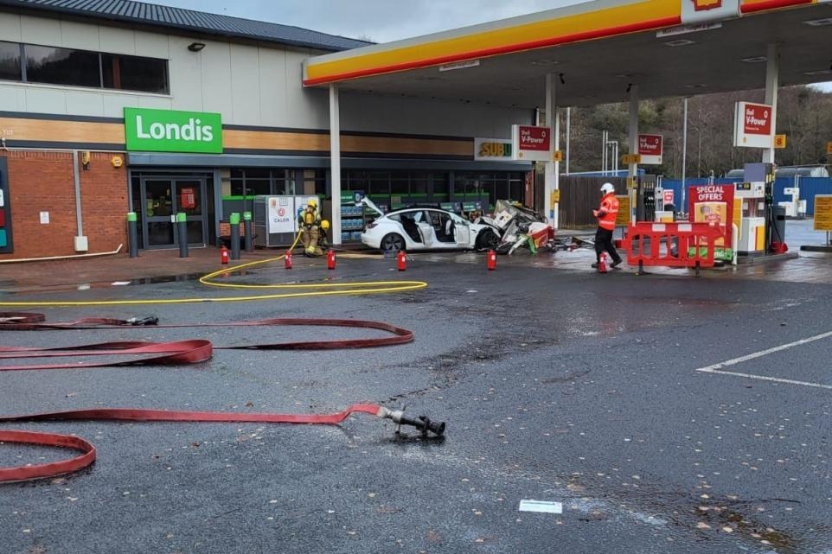
Notes:
A Tesla crashed into a pump at a Herefordshire petrol station and left it completely destroyed. No real signs of fire damage. This has happened countless times with ICE vehicles.

Slide 10
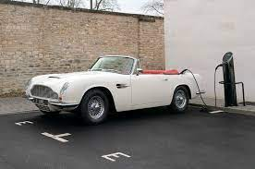
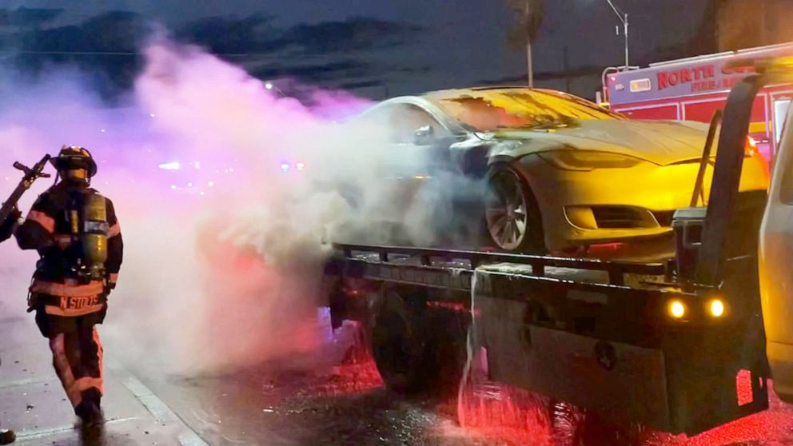
Hazards and Precautions for
First Responders
Identifying Electric vehicles
Damaged EV’s at Road Traffic Collisions
Re-ignition
Incidents occurring in tunnels or enclosed spaces
Moving an EV post incident
Floods
Vehicle Recovery
Notes:
Some classic cars have now been retrofitted with lithium batteries. You could now attend an RTC involving a classic mini or a nice Jaguar E type and assume it is an internal combustion engine where in fact it is now an EV. It’s also paramount that the type of fuel identified is shared with all partner agencies in attendance.
When approaching an RTC involving an Electric Vehicle, it is important that a safety officer should be deployed not only to monitor crews using heavy cutting equipment but to also use a thermal imagining camera and monitor any rise in temperature from the battery. The safety officer should also be rigged in full PPE and with a gas detection monitor. The incident commander should give a very clear brief to their safety officer.
If the batteries have been compromised, what appears to be white smoke is in fact a highly toxic flammable vapour cloud. This could result in a snatch rescue if persons are trapped.
If the vehicle is on fire and subsequently extinguished by Fire and Rescue crews, there is the risk of re-ignition.
Moving an Electric vehicle post incident can pose a risk to emergency services personnel due to the regenerative braking systems, adding power back into the battery.
Hurricane Ian in Florida – Suffered considerable floods in 2022, as the water begun to subside, some electric vehicles began to catch fire without warning.
LFB have created a note in PN977 All incident considerations - Crews may need to have a presence and agree a tactical fire plan whilst the vehicle is recovered. Additionally, crews may need to put in place watching brief(s), re inspections, and consider the need to accompany the affected vehicle to its destination (if within London area). An in-depth handover to the Responsible Person (RP) will be required.
Most important – Be safe, this is an emerging risk for fire responders globally, fire tactics around the world are constantly being discussed and adapted, with new equipment being researched and tested.

Slide 11
LFB Transport Liaison and Alternative Energy Group
Sub O Micky Bhasin vivek.bhasin@london-fire.gov.uk
Thanks for listening
Any Questions??

